Slide 1


Slide 2







Voice controlled servo motor using an android application

Slide 3
TEAM MEMBERS
1.P.SAKETH - 2000040116
2.V.V.JATHIN GUPTHA - 2000040153
3 V .LIKITHA - 2000040154

Slide 4

Problem Statement
The project Aim is to control servo motors using voice commands over an android phone.
It is used in Vehicles etc.
Why to make Vehicle's as Automation.
When we are going over speed then we can control by
Voice too with the help of this project.
Who want to perform their work easier they use this method .
What impact does the problem cause:- social problems.
Possible solutions:-
Then we can improve the Automobile cars by this feature.

Slide 5


ABSTRACT
In this paper, a prototype for controlling servo motors using voice commands over an android phone is presented. The prototype includes a DE10-Nano FPGA (Field Programmable Logic Array) board, an RFS card (Terasic wireless communication card), an android phone, a servo motor, and a motor driver board. The DE10-Nano board is a revolutionary FPGA board that is capable of sending precise PWM signals to control the motor. The voice commands were captured using an application we built that can be used with any android phone and is capable of detecting the voice commands and sending them to the FPGA board as ASCII codes. The RFS module secures the wireless communication between the android device and the FPGA board via the HC-05 Bluetooth. The code to run this prototype was written in Verilog and flashed into the FPGA board whereas the android application was built using Android Studio.

Slide 6


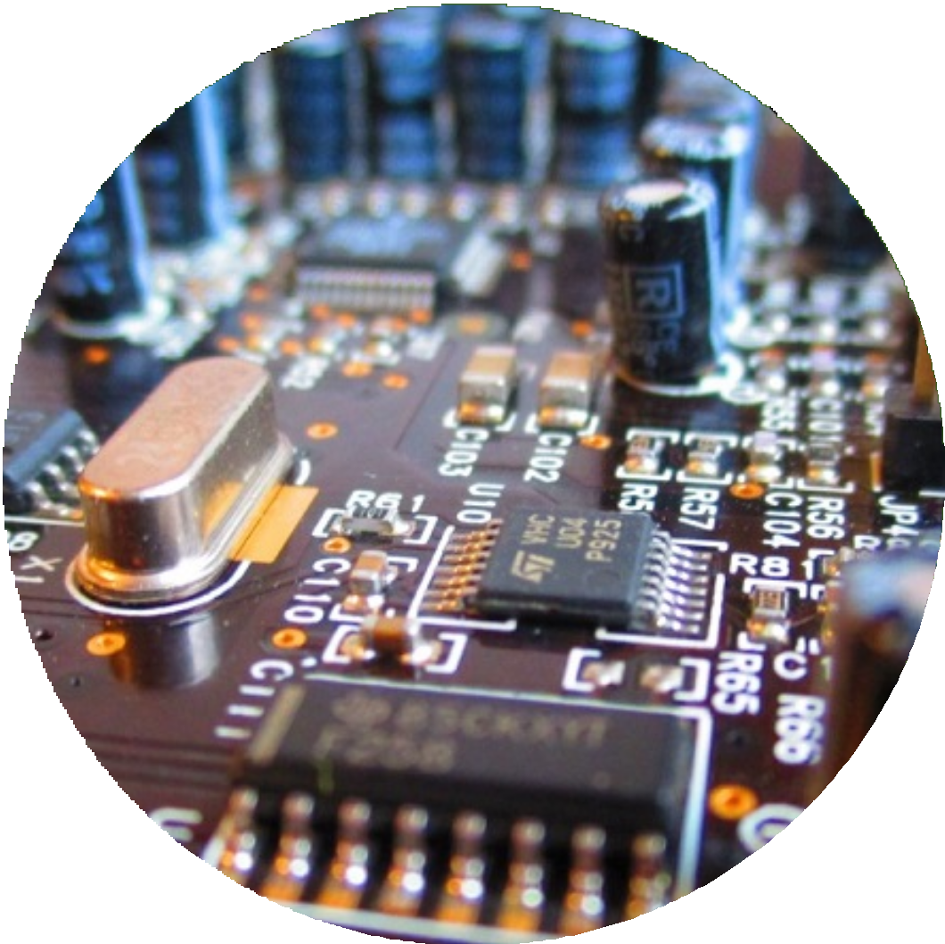


INTRODUCTION:
In this paper, we illustrate the implementation of an android smartphone prototype that accepts human voice as input through its microphone, processes the voice input and sends the processed data over Bluetooth to the DE10-Nano board. This later produces the corresponding PWM signals from the input data received and control the motion of the servo motor connected to the FPGA board via a separate driver board. The prototype demonstrates the suitable motion of the servo motor in terms of angles at multiples of 10 degrees. In the following sections, we will explicitly review the method and implementation involved in terms of hardware and software realizations.

Slide 7

HARDWARE/SOFTWARE REQUIRED:
Arduino
HC-05 Bluetooth module
Servo motor driver(PCA9685)
Servo motor
Android smart phone
12v battery.

Slide 8
Arduino Uno: The Arduino Uno is an open-source microcontroller board based on the Microchip ATmega328P microcontroller and developed by Arduino.
Servo motor driver​ :
A servo motor driver is an electronic circuit that provides the necessary control signals to drive and control a servo motor. Servo motors are small, precise, and high-torque motors that can be positioned to specific angular positions. ​
Bluetooth Module HC-05:
It is used for many applications like wireless headset, game controllers, wireless mouse, wireless keyboard, and many more consumer applications.
It has range up to <100m which depends upon transmitter and receiver, atmosphere, geographic & urban conditions.

Slide 9
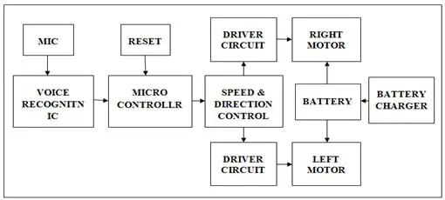
METHODOLOGY

Slide 10
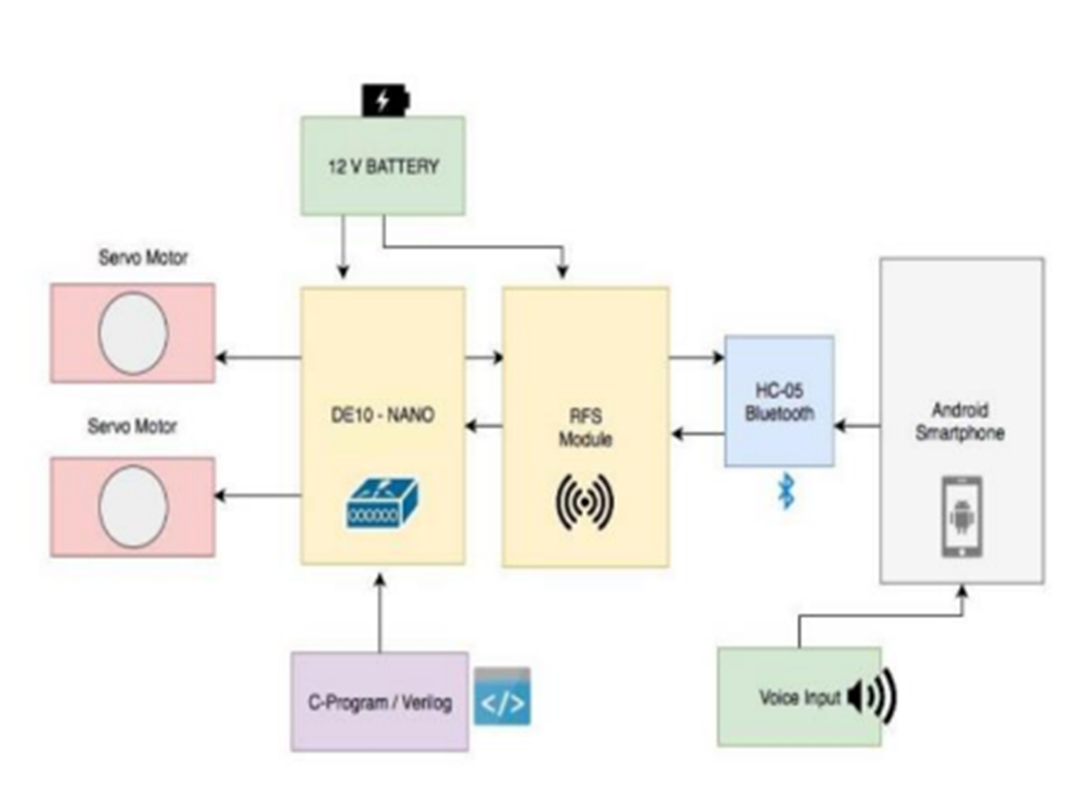
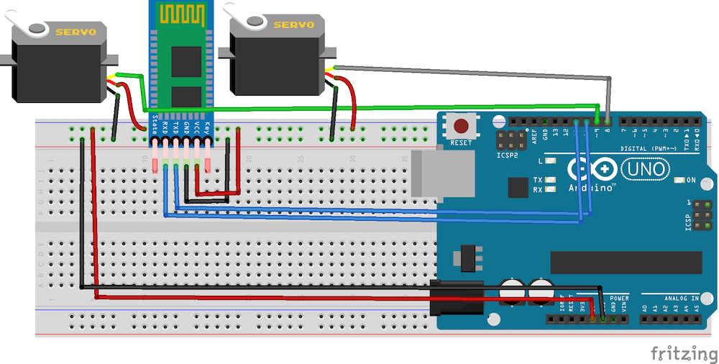
UPDATED METHODOLOGY

Slide 11
LITERATURE SURVEY
A voice-controlled servo motor using an Android application is a system that allows a user to control a servo motor using voice commands through an Android device. The following are some of the Literature survey :
1)"Bluetooth Controlled Servo Motor Using Android Application" is a research paper by S. N. Choudhary et al. published in 2015. The paper describes the design and implementation of a system that allows a user to control a servo motor using an Android device via Bluetooth communication. The system consists of an Android application and a microcontroller that is connected to the servo motor. The Android application sends control signals to the microcontroller, which then drives the servo motor. The authors provide a detailed description of the hardware and software components of the system and present experimental results to demonstrate its functionality. The authors conclude that the proposed system is a low-cost and effective solution for controlling a servo motor using an Android device.

Slide 12
The methodology used in the "Bluetooth Controlled Servo Motor Using Android Application" research paper by S. N. Choudhary et al. (2015) can be summarized as follows:
Design of the Android application: The authors designed an Android application that sends control signals to the microcontroller through Bluetooth communication. The application allows the user to specify the position of the servo motor and sends the corresponding control signals to the microcontroller.
Implementation of Bluetooth communication: The authors used a Bluetooth module to establish a serial communication link between the Android device and the microcontroller. The Bluetooth module receives the control signals from the Android application and sends them to the microcontroller.
Microcontroller-based control system: The authors used an Arduino microcontroller to control the servo motor. The microcontroller receives the control signals from the Bluetooth module and generates the appropriate signals to drive the servo motor.
Integration of the components: The authors integrated the Android application, Bluetooth module, microcontroller, and servo motor to form a complete Bluetooth-controlled servo motor system.
Testing and evaluation: The authors performed experiments to test and evaluate the performance of the system. They measured the response time of the system and evaluated the accuracy of the servo motor position control.

Slide 13
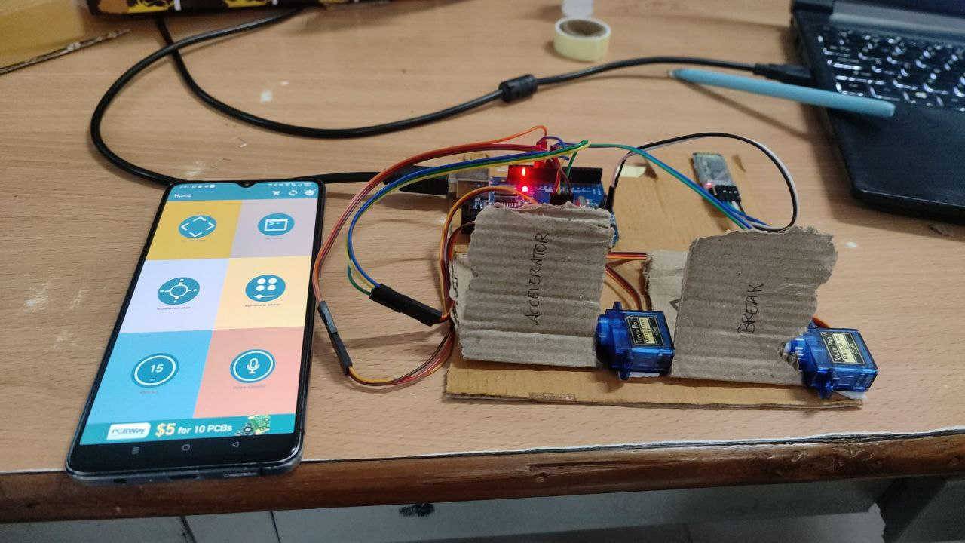
HARDWARE IMPLEMENTATION:-

Slide 14
THANK YOU

